Slide 1


Slide 2
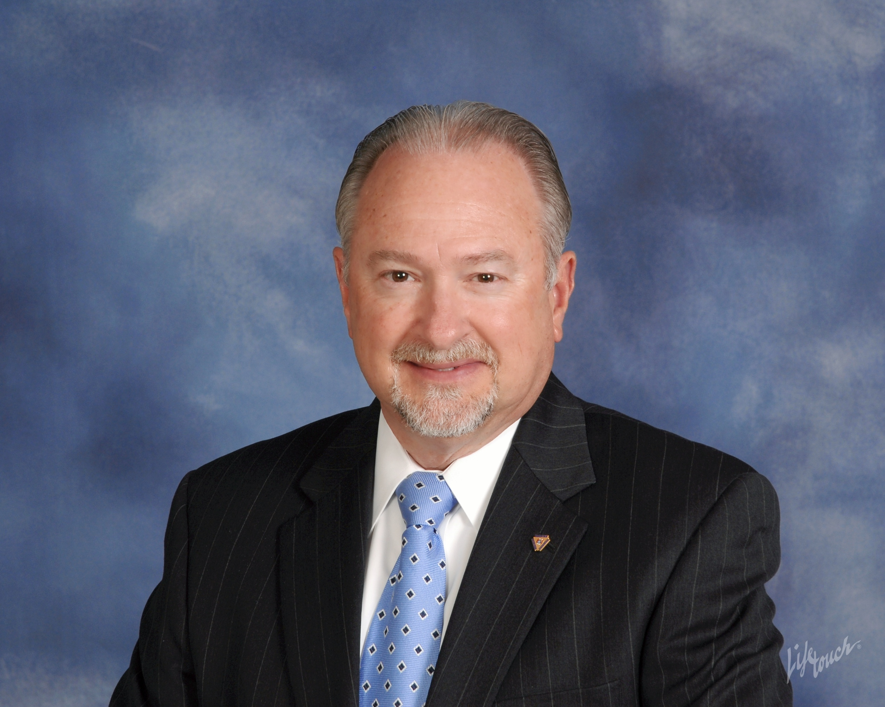
The Rotary Foundation
District 7620
Education Series for 2021-2022
PDG Rich Glover 2018-2019
District 7620 Rotary Foundation Chair 2019-2023
*
Foundation Learning Series Introduction and Appreciation
Why is Rotary International Rotary Foundation one of the most highly respected Foundations in the world
Learn why Rotarians are the engine that provides the resources to serve our communities and around the world

Slide 3


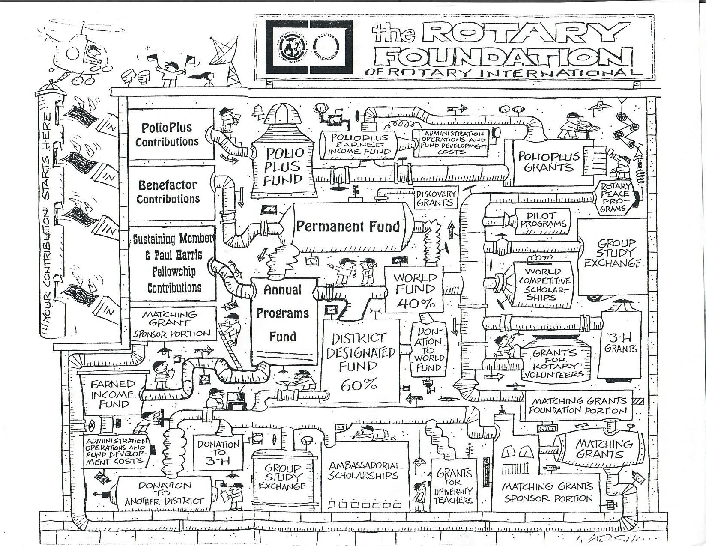
The Firehose Approach of learning
We can do better than this !

Slide 4
The Rotary Foundation learning Series
District Rotary Foundation Chair (DRFC) PDG Rich Glover returns with his series on the Rotary International Rotary Foundation (TRF).
New UPDATES whether this is a review or first-time attendance you will appreciate using the Series Building Blocks for easier understanding and use –
Why the Rotary International Rotary Foundation is one of most highly respected foundations in the world.
Each week an individual part of the series will be available by ZOOM on Thursday evenings and Saturday mornings.

Slide 5

Eight-Part Series every Thursday & Saturday
All members are welcome.
The Club President, President-Elect, Club Rotary Foundation Chair and AG’s are STRONGLY encouraged to attend the complete series.
Part I – Learn the 104 years History of The Rotary Foundation;
Learn about the humble beginnings in 1917 to today as one of the most highly respected foundations in the world.
  Thursday, February 04 @ 7:00 – 8:00 pm, and
  Saturday, February 06 @ 9:00 - 10:00 am
Part II - Learning the Mechanics of The Rotary Foundation; Learn how the TRF works and why it is the “Engine” that drives our districts giving
  Thursday, February 11 @ 7:00 – 8:00 pm, and
  Saturday, February 13 @ 9:00 – 10:00 am
Part III – Be Prepared to Apply for District Grants; Learn about the Memorandum of Understanding (MOU) for community and global grants eligibility, where do we apply, easy steps of the application, and how do we get funded.
  Thursday, February 18 @ 7:00 – 8:00 pm, and
  Saturday, February 20 @ 9:00 – 10:00 am
Part IV – Be Prepared to Apply for Global Grants; Learn about the where and how do we apply, easy steps of the application tips, and how do we get funded.
  Thursday, February 25 @ 7:00 – 8:00 pm, and
  Saturday, February 27 @ 9:00 – 10:00 am
Part V - Your Legacy; Rotary’s Promise: Learn the many ways to establish your own legacy in support of The Rotary Foundation
  Thursday, March 11 @ 7:00 – 8:00 pm, and
  Saturday, March 13 @ 9:00 – 10:00 am
Part VI – PolioPlus; “We are that close” to eradication of Polio in the world. And what is the “Plus"?
  Thursday, March 18 @ 7:00 – 8:00 pm, and
  Saturday, March 20 @ 9:00 – 10:00 am
Part VII – 2021 Annual Foundation Dinner featuring Legacy Donor Recognition; Join in for a Annual Foundation Recognition Dinner
  Thursday, March 25 @ 7:00 – 8:00 pm, and
  Saturday, March 27 @ 9:00 – 10:00 am
Part VIII – Paul Harris Fellow vs. Paul Harris Society; “Why is the Difference so Significant?”
  Thursday, April 01 @ 7:00 – 8:00 pm, and
  Saturday, April 03 @ 9:00 – 10:00 am

Slide 6
The impact in our community and around the world is by the rotary foundations world renown stewardship of our contributions
our money is the engine to impact & sustainability
As a global organization, we are efficient with over 92% of the funds raised going to programs. This efficiency contributes to significant recognition from independent evaluators. TRF has received yet another four-star rating from Charity Navigator, America’s largest independent charity evaluator. This is the thirteenth consecutive year that TRF has received a four-star rating.
Only 1% of the charities they evaluate have received at least ten consecutive four-star evaluations.
Charity Navigator rates over 9000 charities and only about 60 receive 4 stars.
How many charities are in the US? Over a million. TRF is also #1 of the listed charities on GuideStar website as one of the ten best charities that everyone’s heard of.
Last year we were named “World’s Outstanding Foundation” by the Association of Fundraising Professionals
Notes:
( JIM ) Let’s remind ourselves why we are so blessed with the matching funds through our annual giving. The Fund Managers and Board of Directors ha e wisely and efficiently received recognition from around the world for the outcomes and stewardship of our contributions. Award winning global organization graded because how well we are stewards of your money. 92% of TRF funds go to programs, Charity Navigator rates over 9000 charities and only about 60 receive a four star rating. TRF has received the 4 star rating for 12 years in a row. Only 1% of charities evaluated by Charity Navigator have received10 consecutive years with a 4-star rating. There are over a million U.S. charities and TRF is #1on GuideStar's website as one of the ten best charities that everyone has heard of. This is why we are promoting TRF Legacy Fund opportunities.

Slide 7
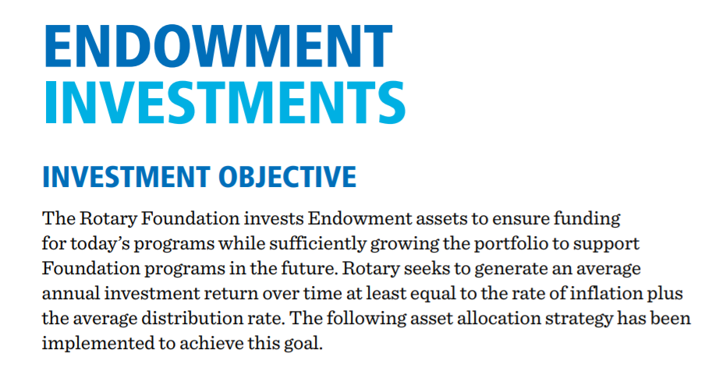
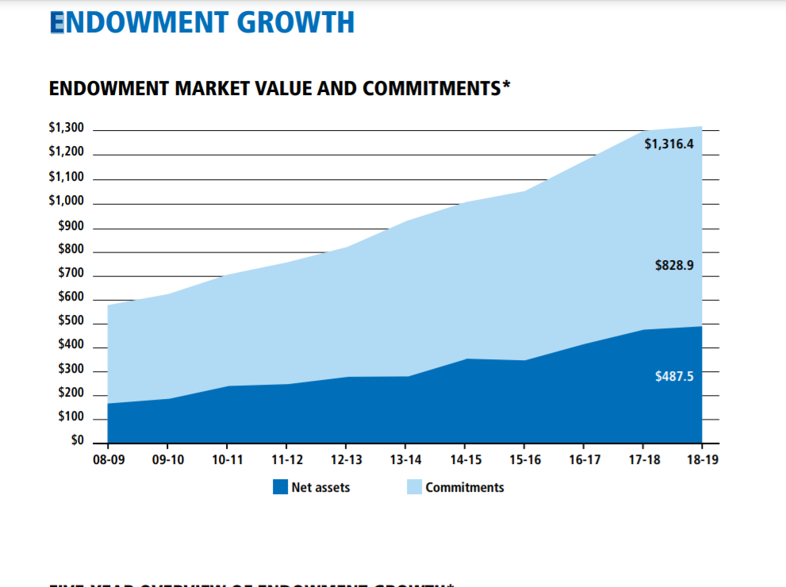
Strategy Results

Slide 8
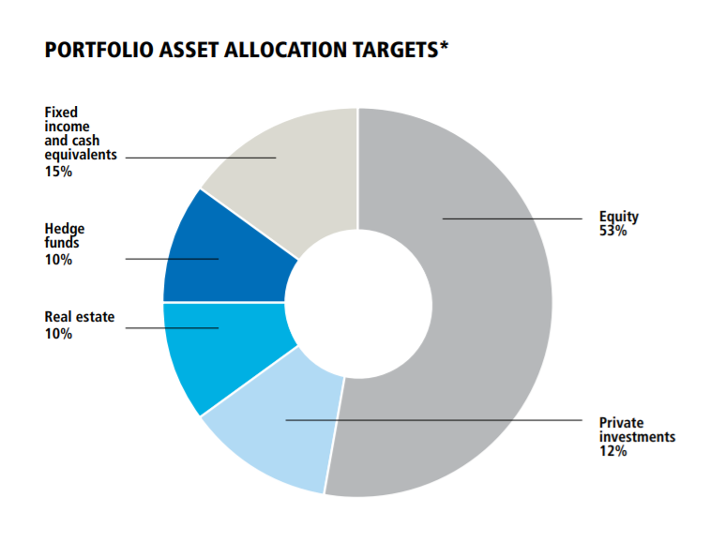
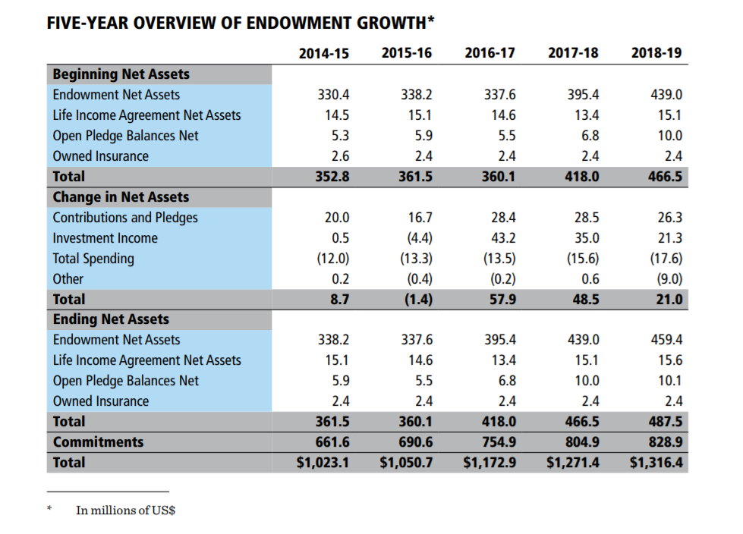
More impressive work by our TRF portfolio managers
Asset Targets
Five Year over view of Growth

Slide 9
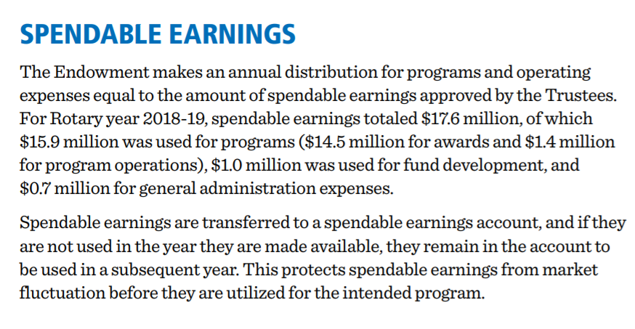
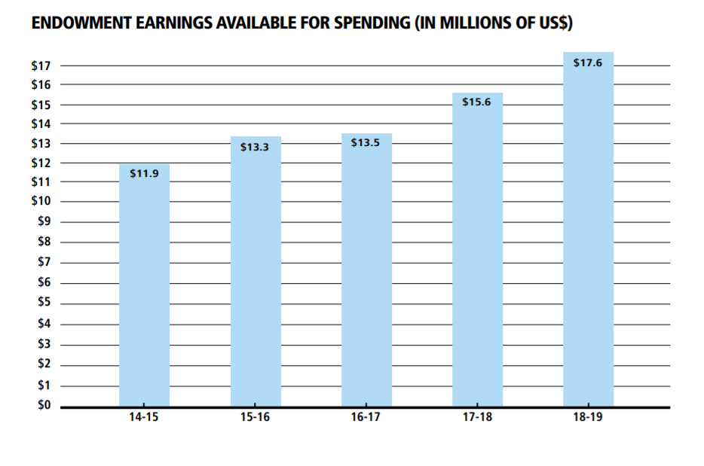
Endowment INVESTMENT EARNINGS

Slide 10
Worldwide Events
WWII
Hong Kong flu 1M perished
Energy crisis & recession
Depression
Black Monday & recession
Asian financial crisis & dotcom bubble
2008 recession & EU debt crisis
Membership
Giving (USD)
Notes:
What impact have worldwide events had on Membership and Giving in the past?
Membership over the years shown alongside economic & health events
Giving Amounts those years alongside economic & health events

Slide 11


Slide 12
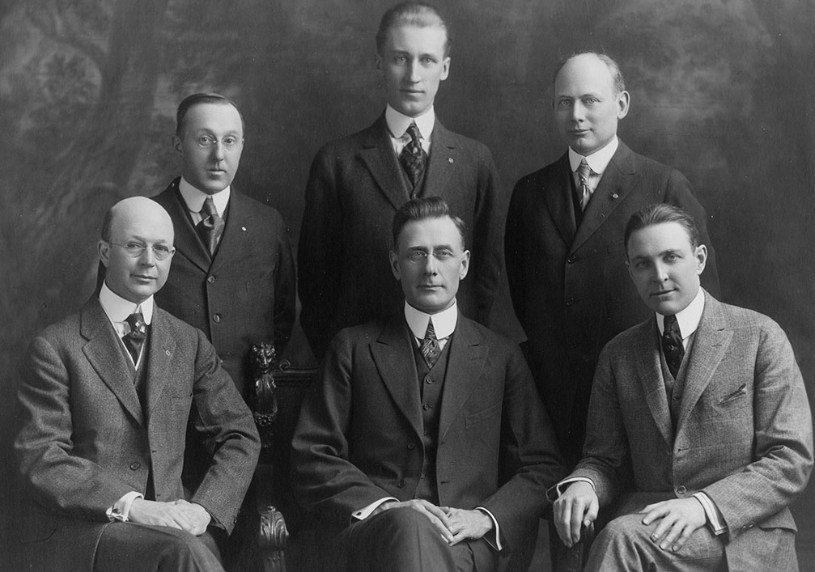
Arch Klumph’s Vision — 1917
Rotary’s 1917-18 Board of Directors
Notes:
* The 1917 convention delegates agreed with Arch’s vision and voted to amend the Rotary constitution to establish an endowment fund.
This fund was “to be made up of contributions from clubs, individuals, estates and other sources.”
The fund’s principal was to remain intact, with only the interest used to further Rotary’s goals. The delegates named Rotary’s Board of Directors as trustees of the fund.
Although this fund started the Foundation, it is not the same as today’s Endowment Fund, which was established in the 1980s.

Slide 13
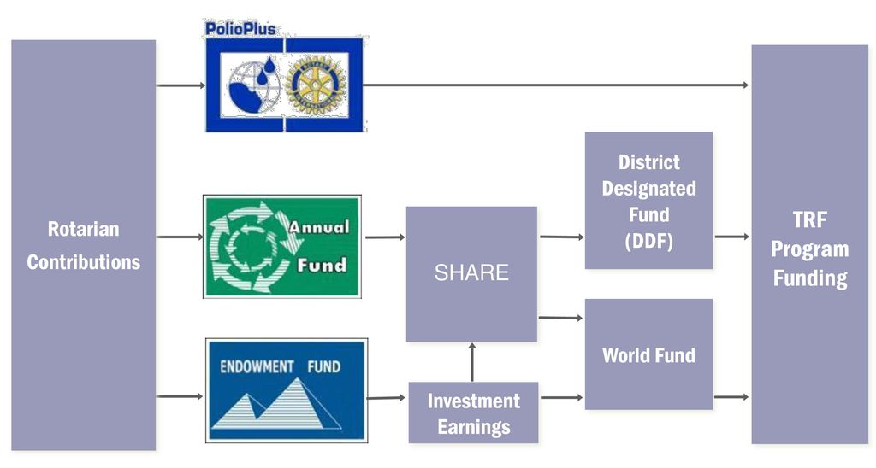
The Annual fund is the engine that drives our district giving

Slide 14
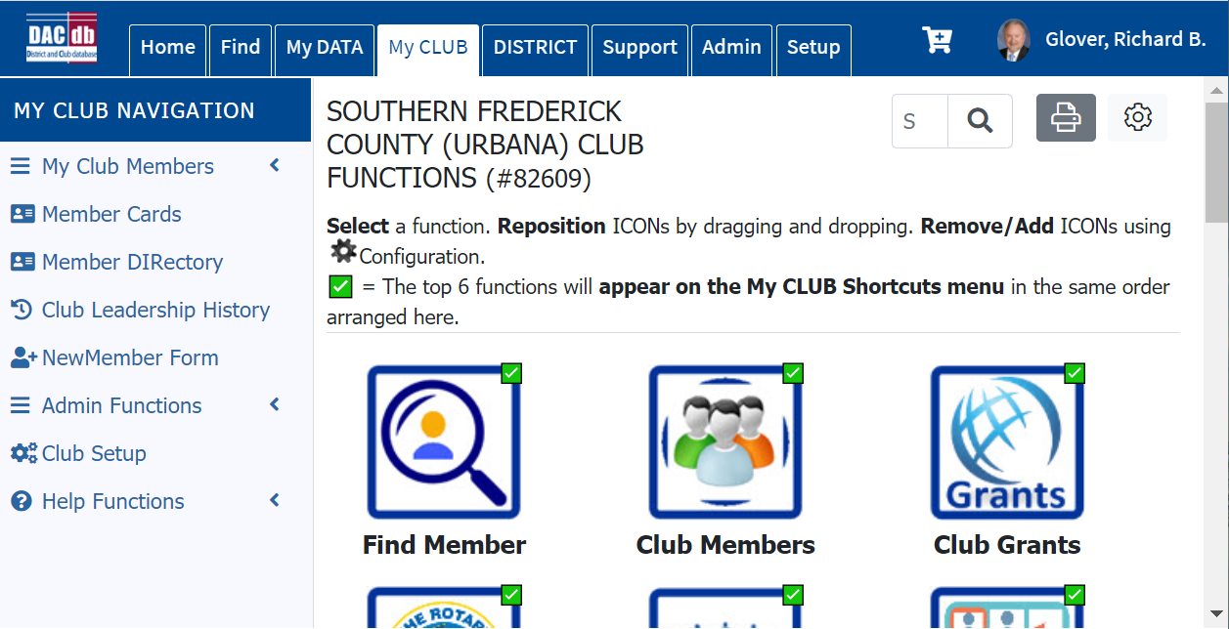
DACdb Module 4 Community Grants
1
3
2

Slide 15
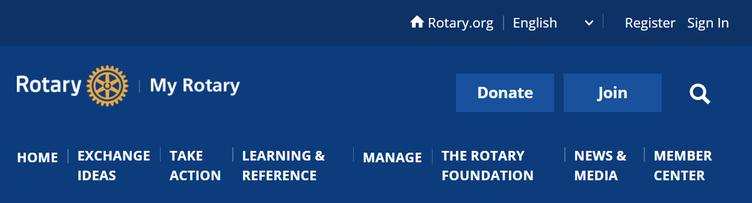
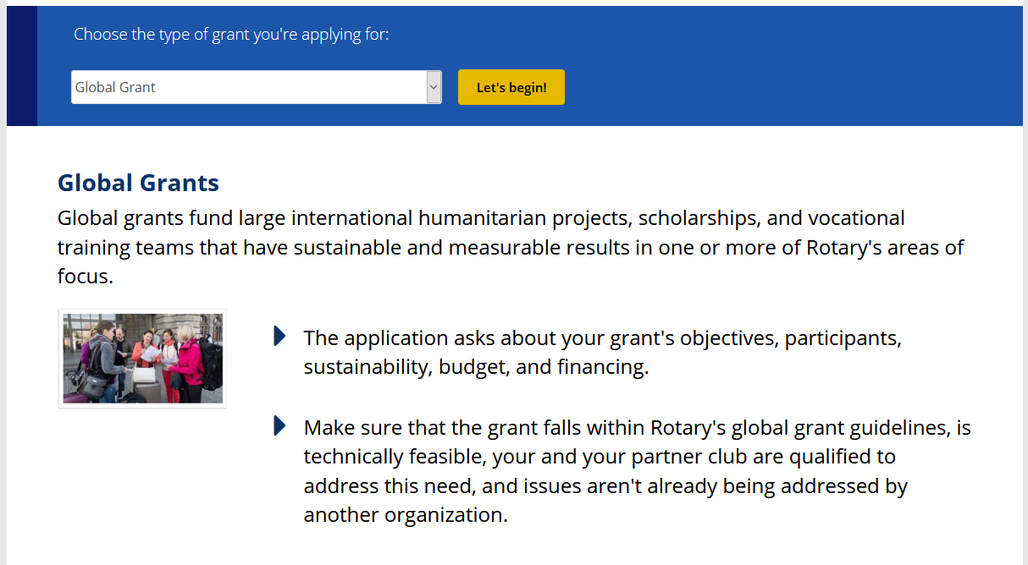
www.MYROTARY.org
Global Grants
1
2

Slide 16


“May our happiness increase with our usefulness. What Rotary will be one hundred years hence, none living can imagine.”
- Paul Harris, Founder of RI

Slide 17
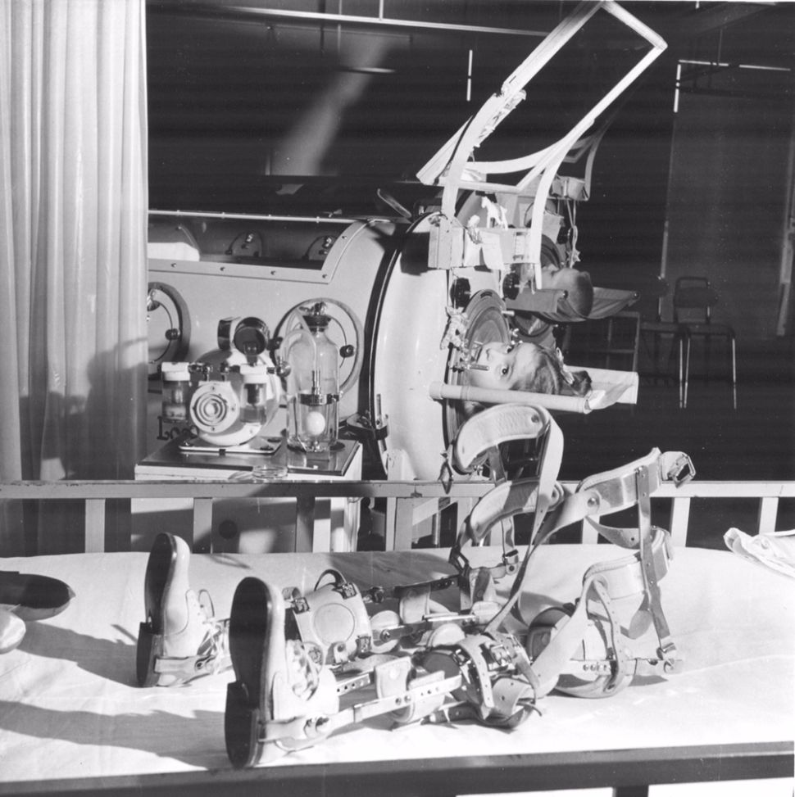

“We are that Close”
The Iron Lung
National Immunization Day

Slide 18
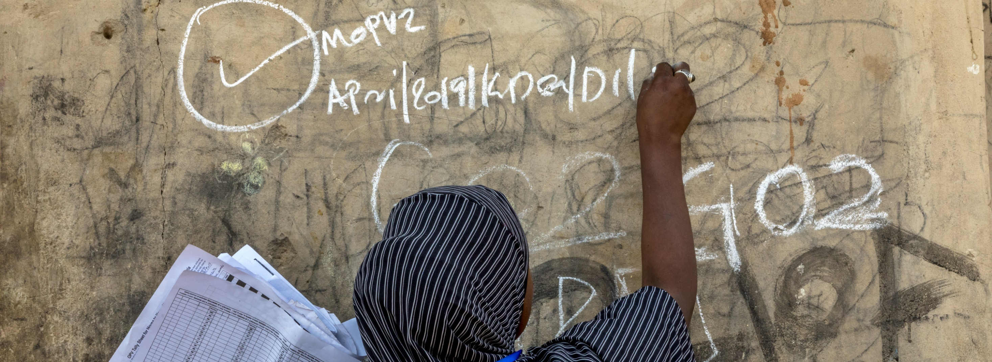
District 7620
Member Donors and Club Recognition Dinner 2021
Featuring special Recognition for our Legacy Fund Donors
Sunday, November 21, 2021, 6:00pm – 9:00pm
TuRf Valley Resort & Conference Center
2700 Turf Valley Rd, Ellicott City, MD 21042
Notes:
( RICH ) We are announcing a 12 month Campaign to continue the awareness of the value of the TRF.
In November 2021, we will have a spectacular event to recognize and present appreciation to our donors to the TRF.
The legacy funds campaign will be significant on this evening, as we have not had a campaign of this sort in recent memory.

Slide 19
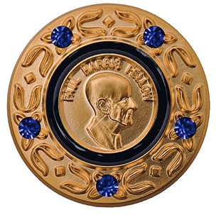

Donor Recognition
Paul Harris Fellow
Paul Harris Society
Paul Harris
Club Banner
The Foundation’s first form of donor recognition was Paul Harris Fellow recognition, which the Foundation began using
in 1957 to express appreciation for donations of more than $1,000. Donors are named Multiple Paul Harris Fellows with
each additional eligible gift of $1,000. Donors may also name another person as a Paul Harris Fellow by donating
in his or her honor.
The number of Paul Harris Fellows reached the 1 million mark in 2006, and more than 1.5 million have been named to
date
Apart from being Paul Harris Fellows, some donors become members of the Paul Harris Society. These are Rotary
members and friends of Rotary who contribute $1,000 or more yearly to the Annual Fund, PolioPlus, or approved
Foundation global grants. This form of recognition was administered by districts until 2013, when the Foundation
Adopted the Paul Harris Society as one of its official programs.
In the 1980s, the Foundation began recognizing contributors who make eligible cumulative donations of $10,000
as Major Donors.
In 1984-85, the Foundation established Benefactor recognition for donors who either include the Endowment Fund as
a beneficiary in their estate plans or donate $1,000 or more to the fund outright.
In 1999, the Trustees started the Bequest Society, which recognizes those who give at least $10,000 to The Rotary
Foundation through their estate plans.
EXTRAS:
Learn about donor recognition at www.rotary.org/take-action/give/recognition
Read more Paul Harris Fellow history at www.rotary.org/history-paul-harris-fellow-recognition
Notes:
* The Foundation’s first form of donor recognition was Paul Harris Fellow recognition, which the Foundation began using in 1957 to express appreciation for donations of more than $1,000. Donors are named Multiple Paul Harris Fellows with each additional eligible gift of $1,000. Donors may also name another person as a Paul Harris Fellow by donating in his or her honor.
* The number of Paul Harris Fellows reached the 1 million mark in 2006, and more than 1.5 million have been named to date
* Apart from being Paul Harris Fellows, some donors become members of the Paul Harris Society. These are Rotary members and friends of Rotary who contribute $1,000 or more yearly to the Annual Fund, PolioPlus, or approved Foundation global grants. This form of recognition was administered by districts until 2013, when the Foundation adopted the Paul Harris Society as one of its official programs.
* In the 1980s, the Foundation began recognizing contributors who make eligible cumulative donations of $10,000 as Major Donors.
* In 1984-85, the Foundation established Benefactor recognition for donors who either include the Endowment Fund as a beneficiary in their estate plans or donate $1,000 or more to the fund outright.
* In 1999, the Trustees started the Bequest Society, which recognizes those who give at least $10,000 to The Rotary Foundation through their estate plans.
EXTRAS:
Learn about donor recognition at www.rotary.org/take-action/give/recognition
Read more Paul Harris Fellow history at www.rotary.org/history-paul-harris-fellow-recognition

Slide 20
Creation of an ENDOWMENT FUND TO BENEFIT district 7620 clubs
On January 14, 2021, after considering options for using the District’s “excess” funds, the District’s Finance Committee unanimously approved establishment of an Endowment Fund in the amount of $100,000 within the Rotary Foundation to benefit District 7620 clubs. That recommendation was forwarded to the District Governor and The District Executive Leadership Team (DELT).
On January 18, 2021, after thorough deliberation and discussion, the DELT unanimously approved the Finance Committee’s recommendation to use $100,000.00 of District funds to create a District 7620 Rotary Foundation Named Endowment.
On January 22, 2021, The Rotary Foundation Chief Philanthropy Officer approved the establishment of the
“District 7620 Central MD & DC Endowment Fund”

Slide 21
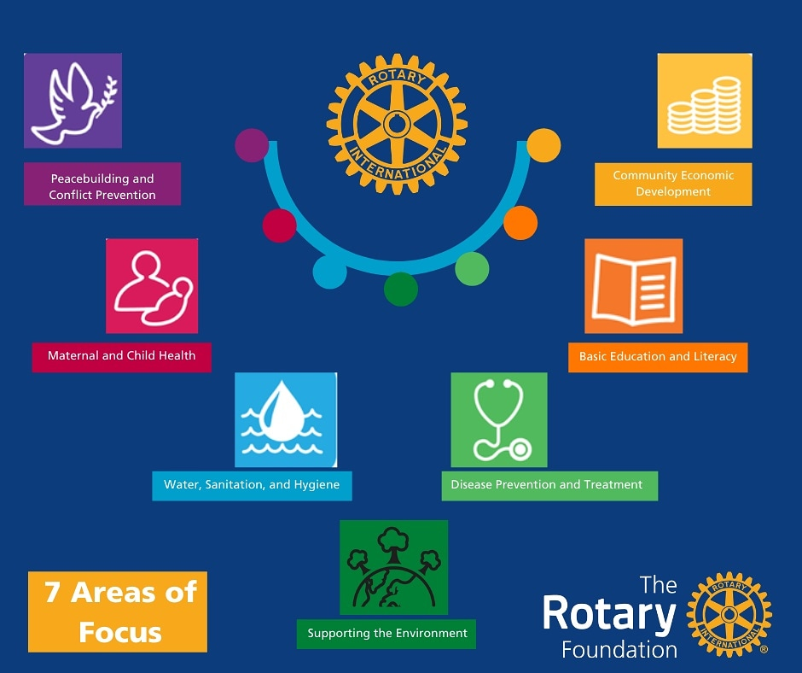
What can your Annual Fund Donations and personal legacy fund support?
DDF-SHARE
World Fund
Area of Focus
Rotary Peace Centers
Global Scholars

Slide 22

REMEMBER – THIS IS THE IMPACT OF EVERY ROTARIAN’S INSPIRATION TO GIVE TO TRF WHICH COMES BACK TO THE DISTRICT ENGINE EVERY THREE YEARS.

Slide 23
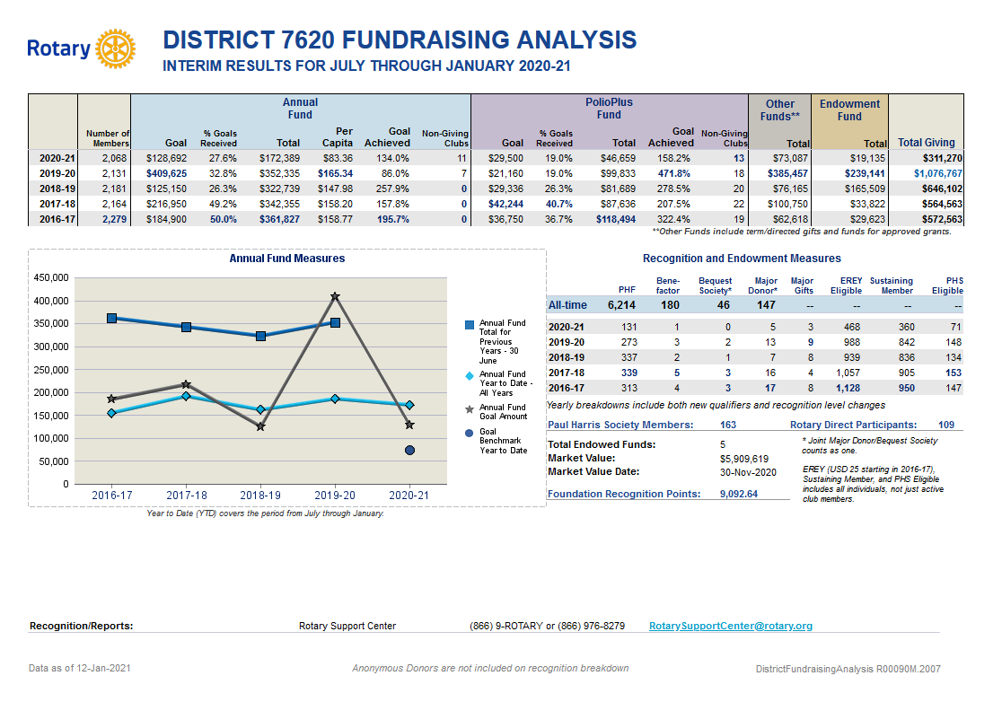

Slide 24
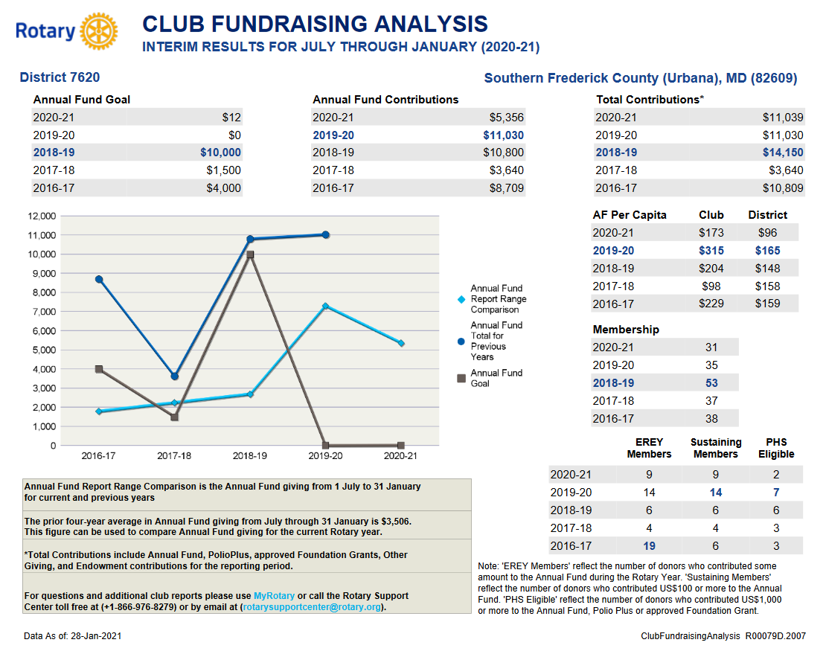

Slide 25

Join us:
Series Building Blocks for easier understanding and use –
ZOOM on Thursday evenings @ 7:00pm and Saturday mornings @9:00am.
Sign-up on District website www.rotary7620.0rg

Slide 26

QUESTIONS
PDG Rich Glover,
District Rotary Foundation Chair
Cell: (301) 980-4976
Email: 18.19.dg7620@glovercrew.net

