Slide 1

Notes:
( JIM ) open up with the welcome of our club colleagues. The attendance of my fellow Rotarians to this program is very meaningful. May I also welcome our DRFC Rotary Rich and the esteemed Zone Major Gifts Officer Laurie Menzel as we walk through our program together.

Slide 2
Attention please
Good Morning and welcome to our TRF Learning Series Part III – Grants !
We have a large attendance today so we request that everyone please mute your Zoom for today’s presentation.
Please use the CHAT icon to place your questions or clarification
The presentation usually has 15 minutes allotted for of Q&A, however, due to the recent TRF Trustee Chair Policy changes, we may have less time.
I will stay after the promised 1 hour limit on all the Learning Series if you wish to stay connected for live Q&A.
IF YOU DID NOT PRE-REGISTER, PUT YOUR NAME, POSITION AND CLUB IN THE CHAT BOX SO YOU RECEIVE ATTENDANCE CREDIT FOR MOU GRANT ELIGIBILITY.

Slide 3
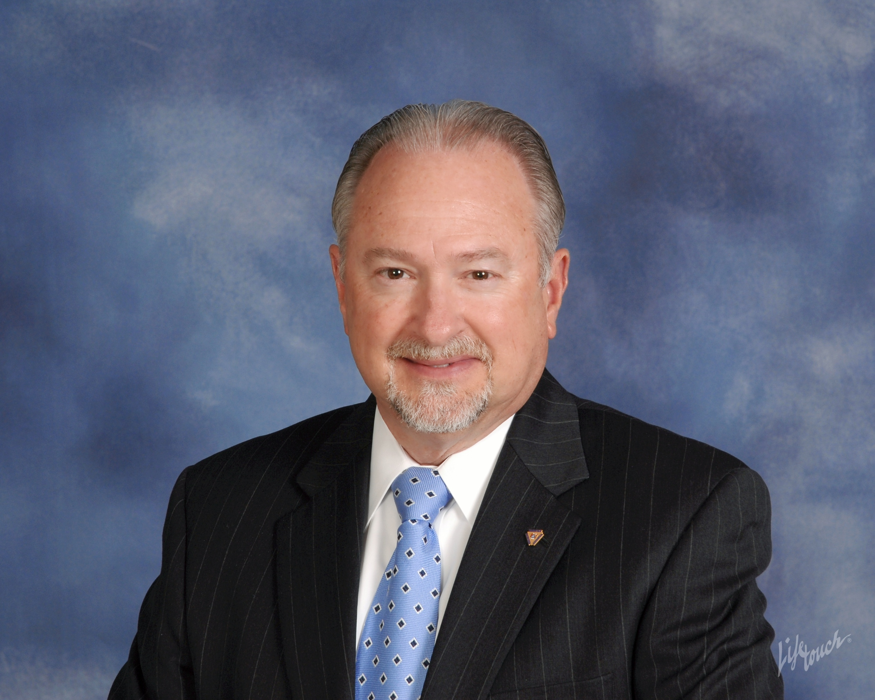
The Rotary Foundation
District 7620
Learning Series for 2021-2022
PDG Rich Glover 2018-2019
District 7620 Rotary Foundation Chair 2019-2023
PART III
District Designated Funds available for Grants:
Be prepared to Apply for a district grant
Memorandum of Understanding

Slide 4
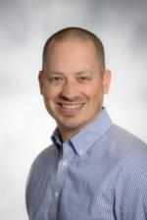
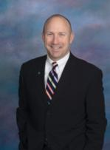
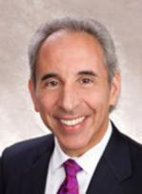
DRFC Special Recognition to D-7620
Rotary Club of Carroll Creek (Frederick)
Reaching a Milestone
Jeff Griffin * Stephen Heine * Dave Petrucci
President President-Elect TRF Chair
Founded August 06, 1993
28th Anniversary of Charter
Members - 187
Average per cap - $160 @ six months
Total Giving - $1,017,153 (as of 02/08/21)

Slide 5
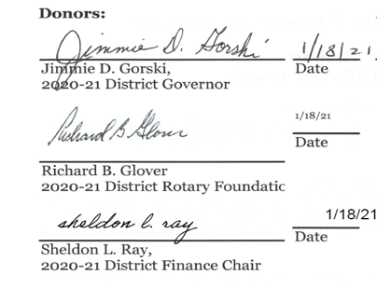
District’s strong financial position leads to creation of an endowment fund to benefit district clubs
On January 22, 2021, The Rotary Foundation Chief Philanthropy Officer approved the establishment of the
“District 7620 Central MD & DC Endowment Fund”

Slide 6
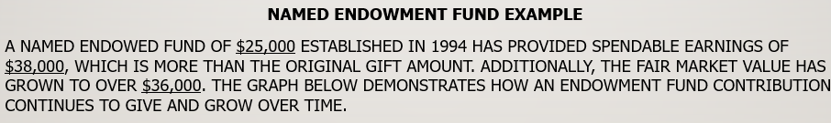
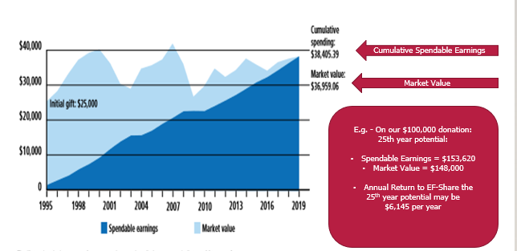

Slide 7
Club member participation in district 7620 central MD & DC endowment fund
Anyone may contribute to the “District 7620 Central MD & DC Endowed Fund.”
Contributions may be made by check, or donations of IRA’s and Stocks .
Contributions by check must identify “District 7620 Central MD & DC Endowed Fund - E12224” as the recipient in the memo section, and must enclose the “TRF Contribution Form #123.” Send to The Rotary Foundation, 14280 Collections Center Drive, Chicago, IL 60693.
To wire funds, please consult the DRFC for wire instructions.
Gifts to the endowment earn giving credits toward the Major Donor recognition.
Gifts to the Endowment do not earn Paul Harris Fellow points or count toward Paul Harris Society.

Slide 8
the district’s endowment fund will supplement club member’s contributions to the annual fund with the endowment Spendable earnings directed to community grants
The Annual Fund,
which represents annual giving by club members to The Rotary Foundation, is the engine that funds DDF District grants and is awarded to clubs to serve those
in our communities and around the globe to live
better lives today.
District 7620 Central MD & DC Endowment Fund
maintains the principal amount in perpetuity, while helping invest to increase market value and generate spendable earnings to the District from the invested funds every year forever.

Slide 9
Let’s us talk about
Community Grants
Criteria Guidelines & Writing Quality Grants
    Clearly state your vision for the project
    Clearly state your Objective(s)
    Clearly state your plan of Sustainability
    Clearly state objectively how it is Measured
    How will the outcome be determined Impactful

Slide 10
Project Vision
What is Our Project Vision?
  A Plan that reflects the desires and interests of Rotary worldwide.
  The Rotary Foundation (TRF) guidelines lead in such a way that our projects demonstrate they are
  SUSTAINABLE, MEASURABLE AND IMPACTFUL
  in our local communities and around the world.

Slide 11
YOUR objectives
    Is it specific * Is it attainable * Is it relevant
    Strengthen impact of club project(s)
    Encourage clubs to work together
    Encourage partnerships with community organizations
    Encourage Creative Innovation
    Advance understanding of The Rotary Foundation’s work
    Enhance Rotary’s public image
    It is time-lined

Slide 12
Principles of Sustainability
    Impact after foundation funding is expended
    Creates regional input and local knowledge
    Respect for the environment & natural resources
    Reach impactful beneficiaries to succeed beyond
    Use innovative methods
    Significantly demonstrate effectiveness of the beneficiaries.

Slide 13
Our plan will be measurable
Clearly identify how you will know objective(s) are accomplished
Always strive for quality
  often defined in quantity
Assure project is attainable - funding, manpower, and authority to accomplish
Assure the project is relevant - Are there factors beyond your control?
Add specific language to specify completion time.

Slide 14
How is the outcome determined impactful
TRF is interested in proof of impact. To evaluate whether time, money, and efforts are making a difference.
Often a community indicators are well-being or program performance metric – Program-level and population level.
Are we turning the curve – beating the data baseline ?
Understand the type and quantity of impact we are making helps us figure out what’s working to change our communities and what needs to be improved.
Claims about making a difference are no longer sufficient; evidence of how much difference you’re making is now required.

Slide 15
Welcome to
“The District and Club database”
DACdb
District Grants – Must apply through DACdb Grant Module
  Grant Applications open March 01, 2021
  Grant Approvals will be announced approximately July 05
  Grants Funds may be awarded beginning the week of July 10
  Grants “Final Report” are due no later than 2400 May 30, 2022
  Failure to comply may result in ineligibility for grant awards in the following Rotary year
  https://www.dacdb.com

Slide 16
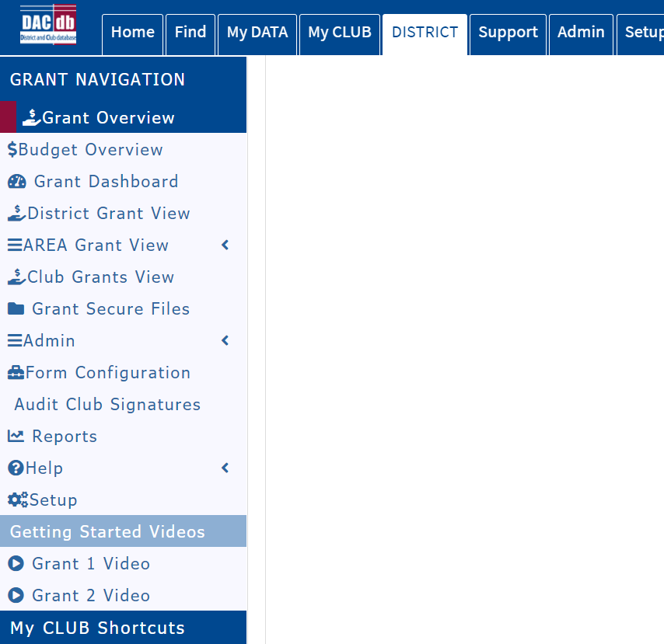
Getting Started DACdb Videos

Slide 17

A quick start process by steps in Grant Module
Login to DACdb.com
Select MY Club (top bar )
Click on icon Club Grants Icon
Under Grants Navigation, Select Admin
Click Club Signature (add at least one club member authorized signature)
Under Grants Navigation, Select Club Grant View
To create Grant, click on New Club Grant Request
All Application Projects START DATE begin no earlier than July 01, 2021.
Follow the prompts from here

Slide 18
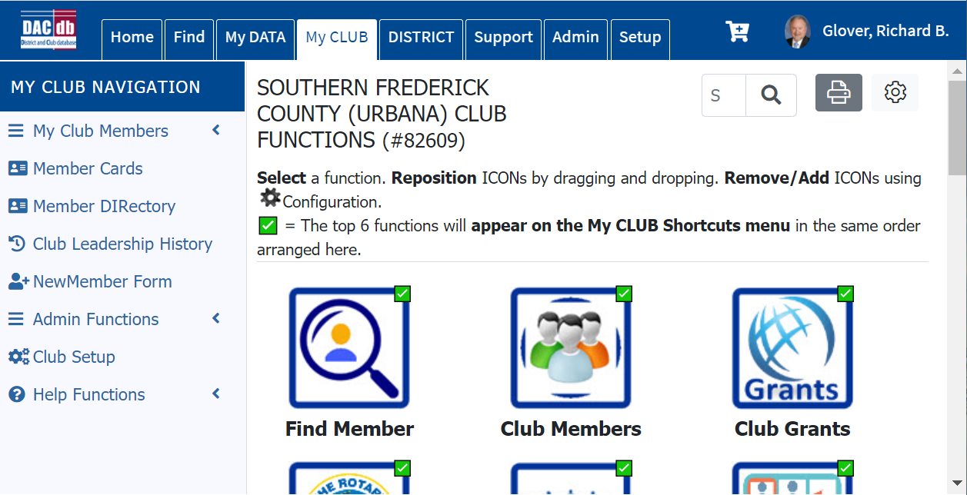
DACdb Module For Community Grants
1
3
2

Slide 19
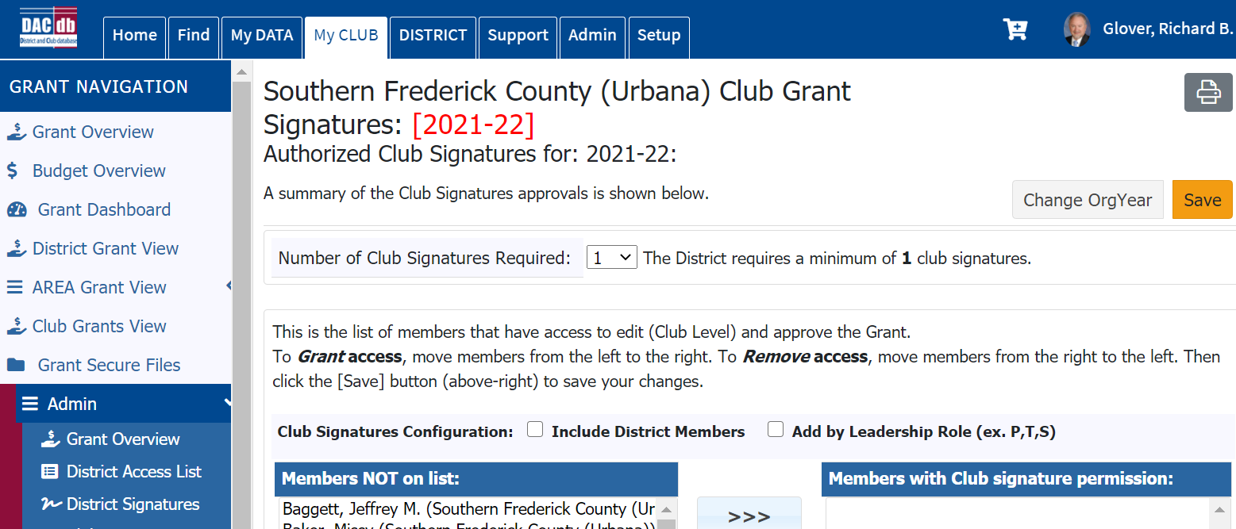

Slide 20
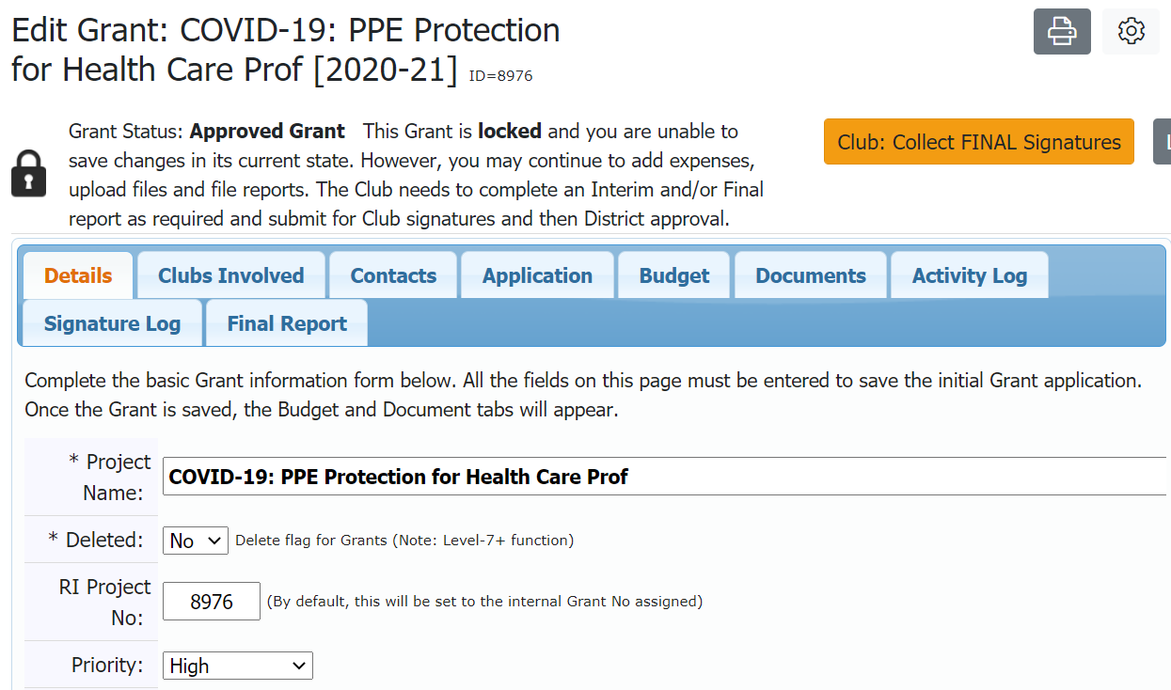
Automatically assigned

Slide 21
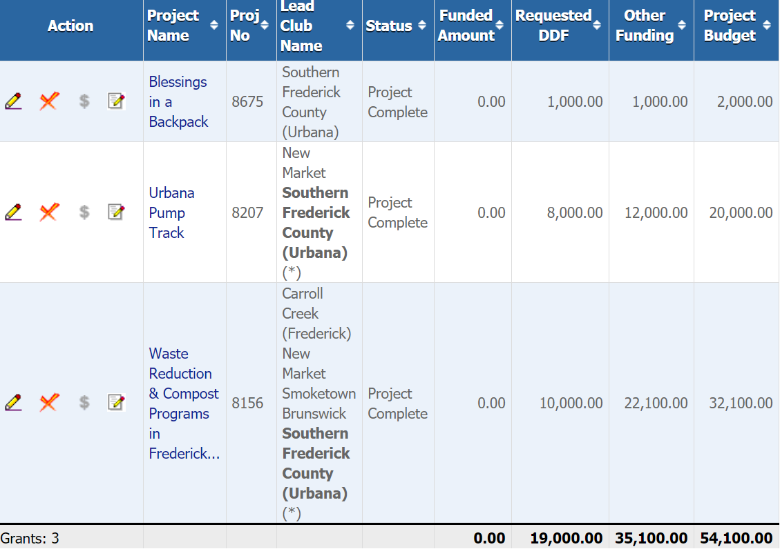
Club Grants View
Manage your Grants
The power of supporting the Annual Fund

Slide 22
Role of District Grants Team
Oversee qualification of Rotary clubs
Serve as resource in grant preparation
Provide content input on District Designated Funds (DDF)
Evaluate, rank and recommended qualified club project proposals
Oversee reporting to the District Rotary Foundation Chair (DRFC)
Report misuses or irregularities

Slide 23
Your 2021-2022 Grants Committee Team
DRFC PDG Rich Glover 18.19.dg7620@glovercrew.net
Grants Committee Chair B.J. Skinner bjcskiner@icloud.com
Grants Sub-Committee Bruce Grant bgrant@estesgrp.com
Grants Sub-Committee Jeremy Robinson jrobinson@hondurascompassion.org Grants Sub-Committee Phil Reynolds philreynolds60@hotmail.con
Grants Sub-Committee Mimi Kandra mk8601@aol.com
Grants Sub-Committee Daniel Fischer Daniel@siolveit.com
Grants Sub-committee May O’Brien mayzobrien@gmail.com

Slide 24
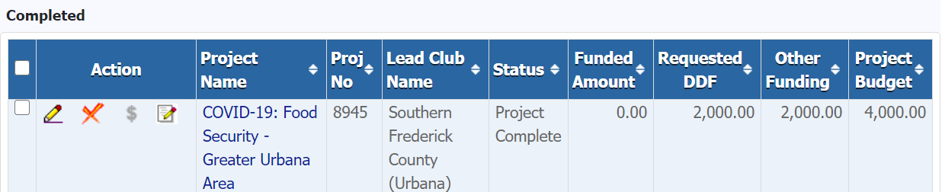
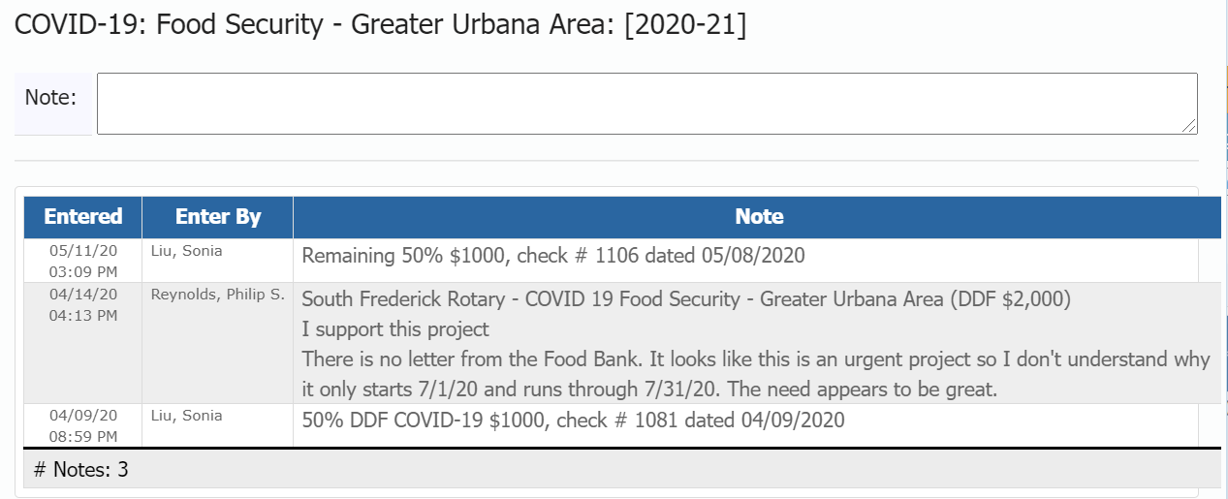
Can everyone see the Notes ?
YES ☺
1
2
3

Slide 25
District Grant pay-out policy
Upon grant approval, club will be notified via DACdb module, and should expect to receive first 50% of approved match in approximately 14 business days.
Once all reporting is complete and approved, club will receive final 50% in approximately 14 business days.

Slide 26
Memorandum of Understanding
MOU is a stand alone document and available on the District 7620 web site under the Foundation tab
Read very carefully to all MOU compliance statements
Each Club must have a Club Rotary Foundation Chair.
Both Club President and Club Rotary Foundation Chair must initial each page (lower right).
Scan and send entire MOU document with officer signatures by email to the District Rotary Foundation Chair (DRFC) not later than date stamped 5:00pm EST, Friday, March 26, 2021. No exceptions.
Any questions are welcome by PDG Rich by email.

Slide 27
TRF Changes effective July 01, 2021 high demand for global grants is far exceeding and outpacing the growth in Annual Fund contributions.
The Rotary year 2021-2022, TRF is taking several cost-saving measures in an effort to fund more global grants.
District Designated Fund (DDF) contributions transferred to PolioPlus will be reduced in matched to 50%.
  E.g. - DDF DG Pledges of $20,000, WF match is $10,000 (50%) = $30,000.
  Gates Foundation still matches 100% on $30,000 providing a $60,000 to Polio Plus Eradication Program.
World Fund match of DDF will be reduced to 80% when being used for global grants.
Annual Fund-SHARE contributions will have a new 5% reduction taken equally (2.5%) from the World Fund and DDF to help fund operating expenses.
The ability to roll over unused DDF-Share will be limited to five years then will be applied at the district’s discretion to PolioPlus, area of focus Endowment funds, the general Endowment Fund (including the Rotary Peace Centers), the Disaster Response Fund, or the World Fund. The first DDF rollover redirection will take place 1 July 2026.

Slide 28
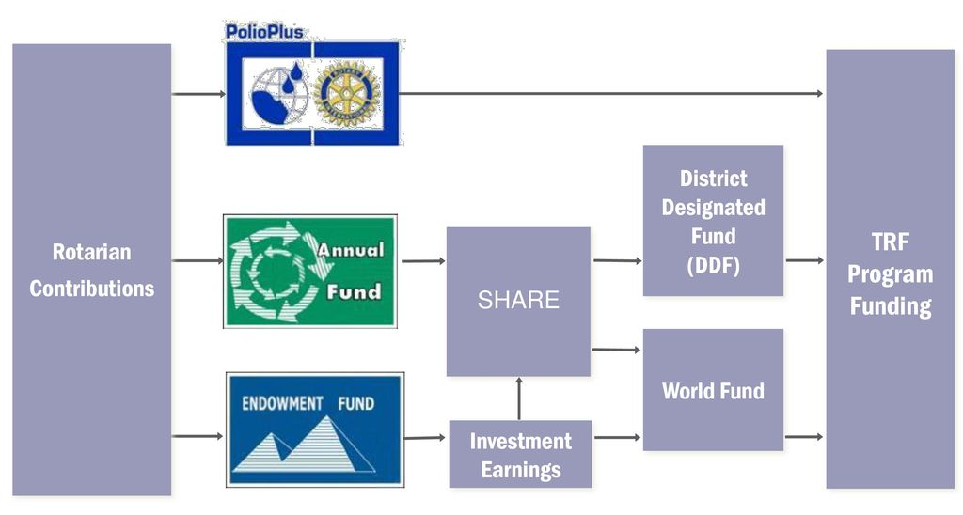
The Annual fund is the engine that drives our district giving
2.5% taken off top for Administrative costs
(E.g. $78 K)
Total Community + club match
$156 K
TRF Holds for
3 yrs.
$23.75
Community
$100
Your investment just turned into $296K
$100
$47.50
$50
$50
$
(E.g. $78 K)
Total Global + GG match
$140 K
80% Match
$23.75
Global
2.5% taken off top for Administrative costs

Slide 29
District Designated Funds (DDF)
Grant Criteria “10”
Memorandum of Understanding (MOU)
1. The Club President-Elect and Club TRF Chair are required to attend annual DACdb Grants Module training Parts II,
III, and IV of the DRFC Learning Series, prior to March 01, 2021.
2. The Club President-Elect and club Foundation Chair are required to be MOU certified (President & Club TRF Chair).
3. The District and Club Data Base (DACdb) is required to submit and manage a district grant, no exceptions.
4. $120 per capita minimum of club membership total giving to the Annual Fund.
5. 50% of club members contribute $25 to the Annual Fund.
6. 50% of club members are a Paul Harris Fellow.
7. $5,000 maximum DDF Match per eligible club
8. 15% is the maximum grant award to any one club of the total District DDF community Grant fund.
9. District community grant projects are required to be complete, submitted and approved “Final Report” by the DRFC no later
than May 30, 2022.
10. Ensure that all grant activities are in accordance with local laws.
FINAL: February 17, 2021 1500 hrs.

Slide 30
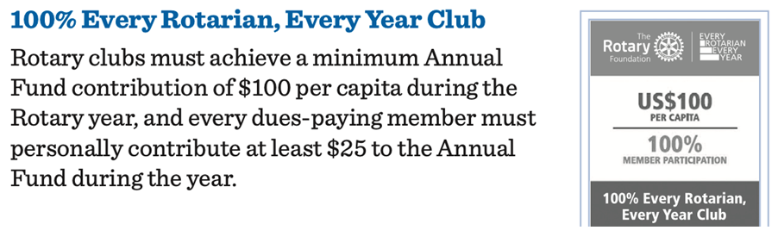
MOU Eligibility for EREY 2020-2021
Rotary TRF club Award VS. 7620 MOU ErEY
MOU Eligibility for EREY by June 30, 2021
MINIMUM of $100 per cap to the Annual Fund.
MINIMUM of 50% club membership contribute $25 to the Annual Fund during the Rotary Year.

Slide 31
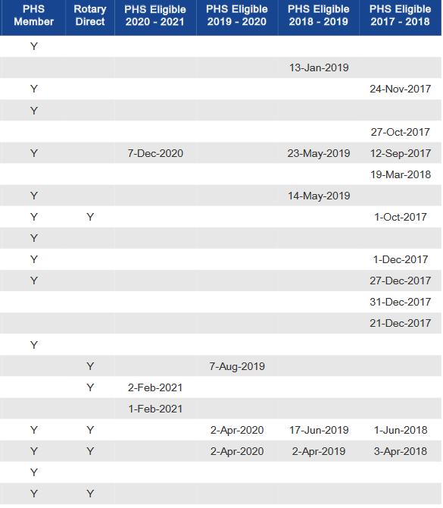
Club TRF Chair management of Club reports is a must and eligibility may depend on it.
Example of a club Paul Harris Society Report

Slide 32
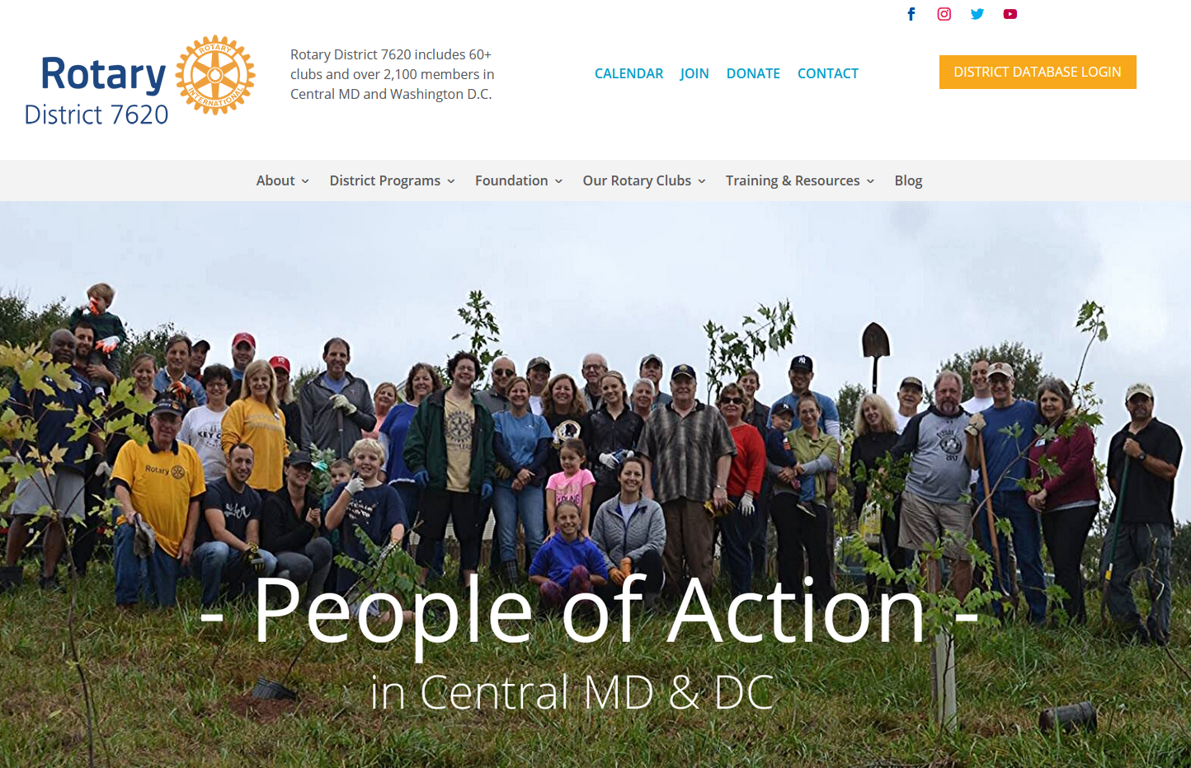

Slide 33
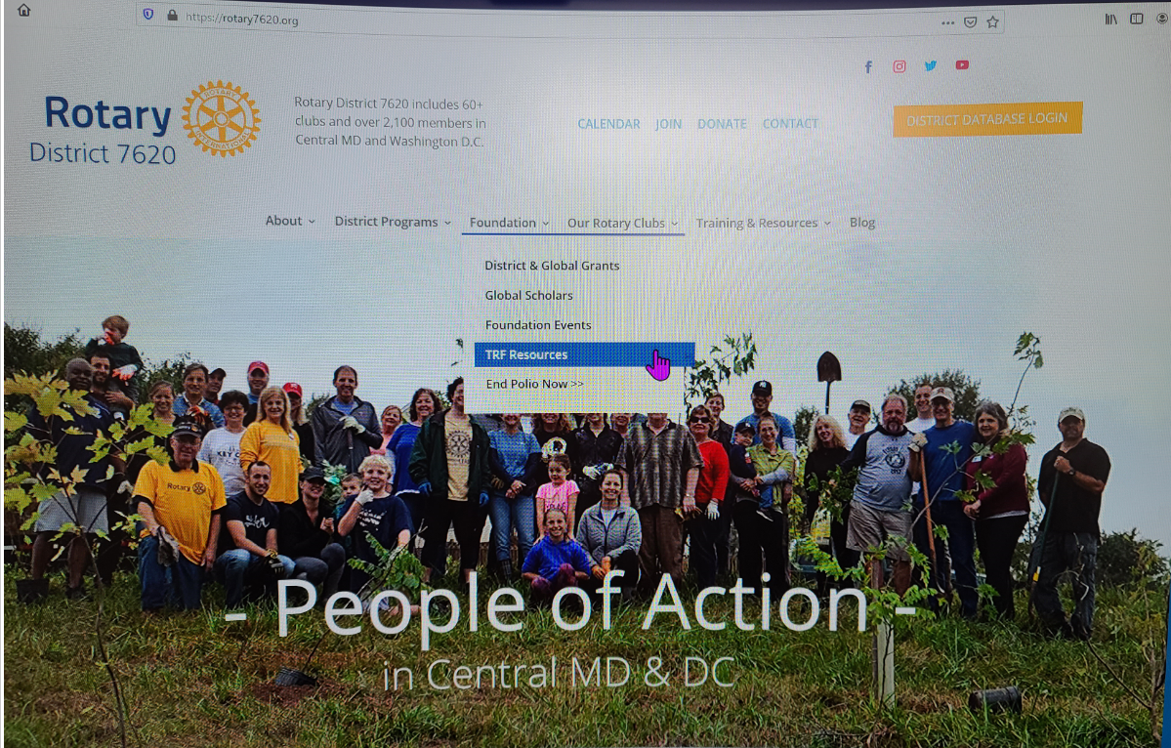

Slide 34
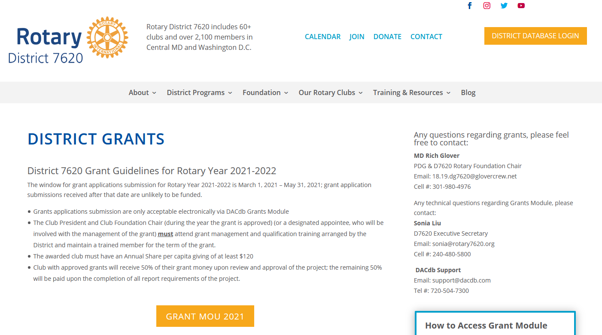

Slide 35

QUESTIONS
PDG Rich Glover,
District Rotary Foundation Chair
Cell: (301) 980-4976
Email: 18.19.dg7620@glovercrew.net

Slide 36
Ways to promote Individual & club recognition and support of the Annual Fund
Use Rotary Direct to establish consistent Annual Fund Support
  1st - Time Paul Harris Fellow recognition
    Use Points Match Opportunities district or club $500 + 500 pts = 1st time PHF
  Paul Harris Society
    $1,000/yr. or $85/mo.
  Every Rotarian Every Year
    $100/year
  PolioPlus $45/yr.

Slide 37
The impact in our community and around the world is by the rotary foundations world renown stewardship of our contributions
our money is the engine to impact & sustainability
As a global organization, we are efficient with over 92% of the funds raised going to programs. This efficiency contributes to significant recognition from independent evaluators. TRF has received yet another four-star rating from Charity Navigator, America’s largest independent charity evaluator. This is the thirteenth consecutive year that TRF has received a four-star rating.
Only 1% of the charities they evaluate have received at least ten consecutive four-star evaluations.
Charity Navigator rates over 9000 charities and only about 60 receive 4 stars.
How many charities are in the US? Over a million. TRF is also #1 of the listed charities on GuideStar website as one of the ten best charities that everyone’s heard of.
Last year we were named “World’s Outstanding Foundation” by the Association of Fundraising Professionals
Notes:
( JIM ) Let’s remind ourselves why we are so blessed with the matching funds through our annual giving. The Fund Managers and Board of Directors ha e wisely and efficiently received recognition from around the world for the outcomes and stewardship of our contributions. Award winning global organization graded because how well we are stewards of your money. 92% of TRF funds go to programs, Charity Navigator rates over 9000 charities and only about 60 receive a four star rating. TRF has received the 4 star rating for 12 years in a row. Only 1% of charities evaluated by Charity Navigator have received10 consecutive years with a 4-star rating. There are over a million U.S. charities and TRF is #1on GuideStar's website as one of the ten best charities that everyone has heard of. This is why we are promoting TRF Legacy Fund opportunities.

Slide 38
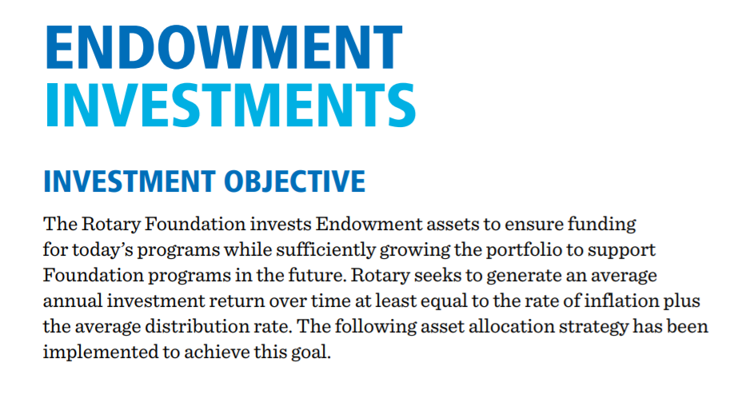
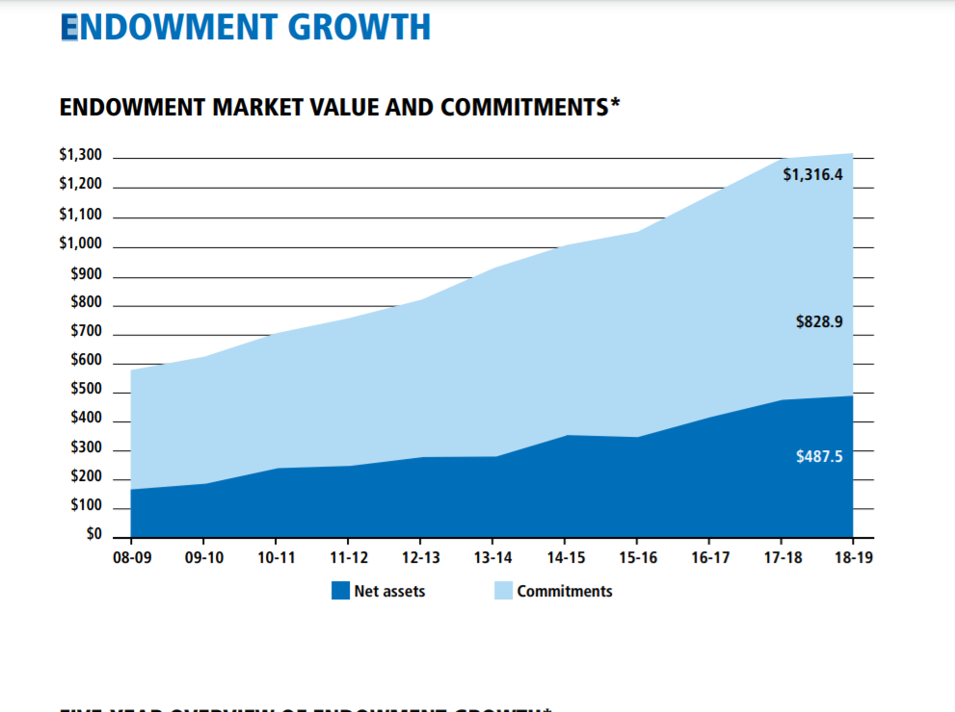
Strategy Results
Now is 1.432 Billion

Slide 39
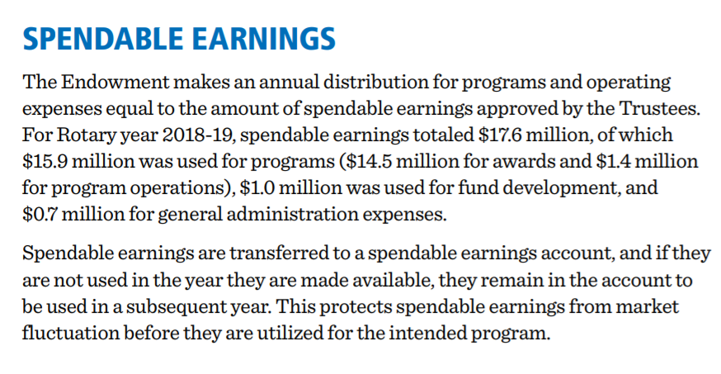
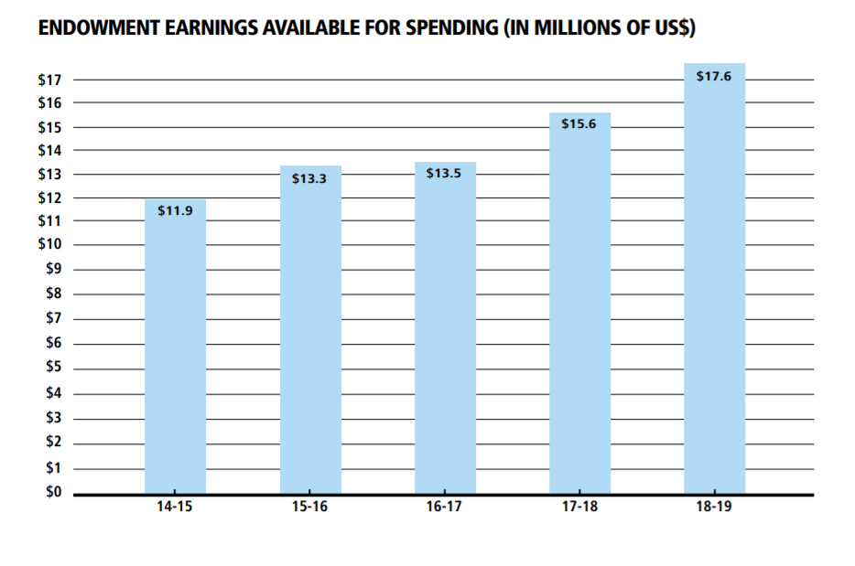
Endowment INVESTMENT EARNINGS

