Slide 1
“Connecting Local Communities” Highlighting local non-profits and businesses teaming up to raise funds to help the local community.
December 19, 2022

Slide 2
2022 Results

Slide 3
Highlights from 2022 Event
Total Dollars Raised: $46,566
First year for Main Street Match and Corporate Sponsors
Approximately 50,000 attendees to Christmas in Davidson
Visitors liked the new layout for the Christmas Tree Village

Slide 4
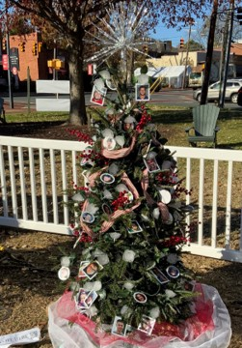
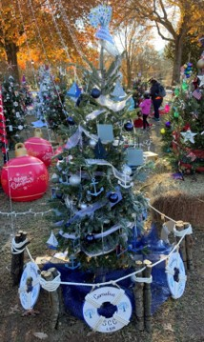
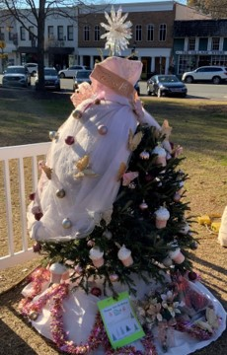
Top Dollar Vote Getters
The Herren Project
Senior Community
Connections
Caterpillar Ministries

Slide 5
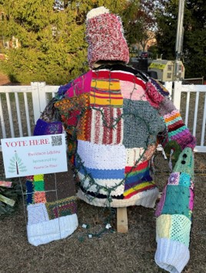
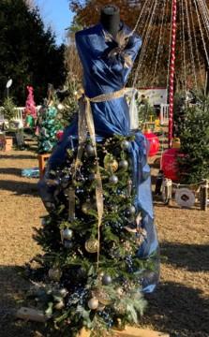
Top number of Individual Votes
The Herren Project
Davidson Lifeline
Hope House Foundation

Slide 6
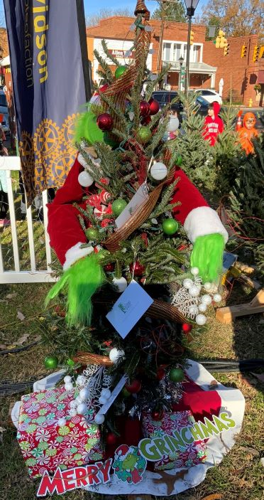
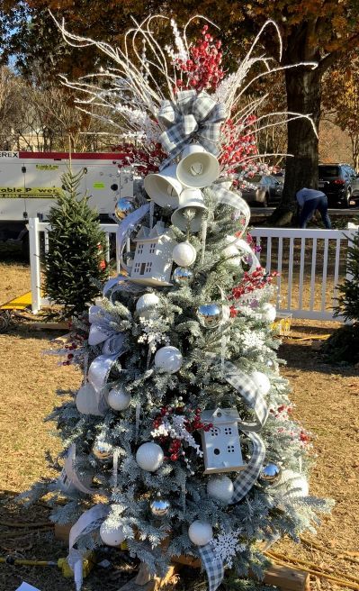
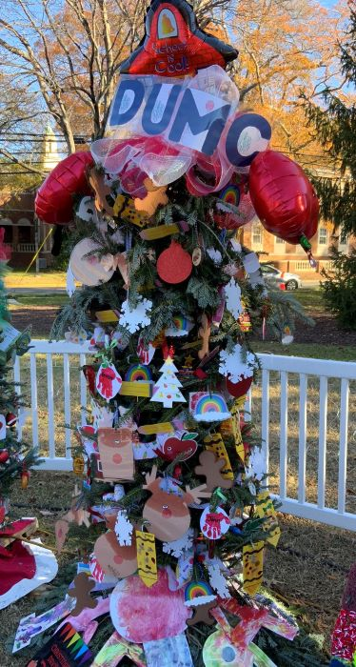
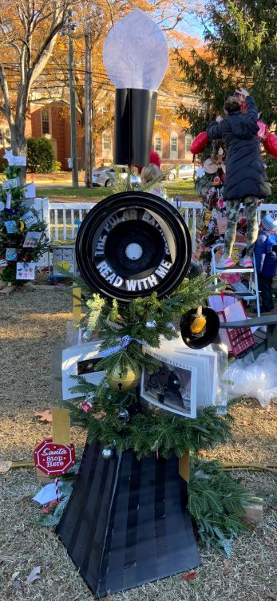
Categories
Kids Favorite
Prettiest
Most Educational
Most Creative

